Slide 1
Agents Council for Technology
October 2015 Meeting
NOLA
Oct 2, 2015

Slide 2
WELCOME!
#ACT4Agents

Slide 3
New ACT Member

Slide 4
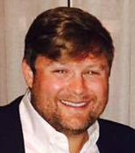
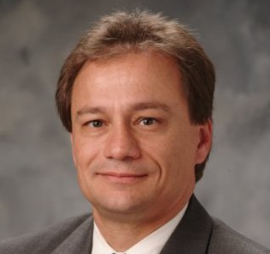
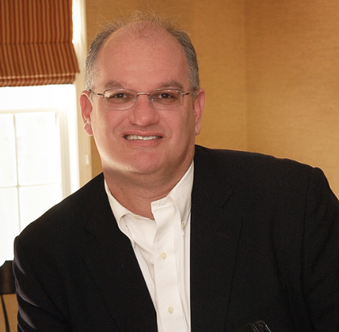
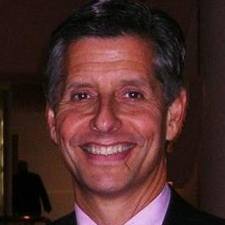
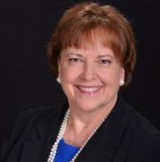
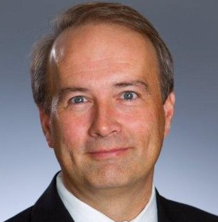
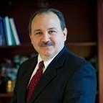
ACT Committee
Boyd McGehee Young Agents Committee Liaison
Jon Jensen IIABA Executive Committee Liaison
Jay Byrnes ACT Committee Chair
Steve Aronson
Claudia McClain
George Robertson
Scott Lindsey

Slide 5
ACT Mission statement
Our mission is to bring the stakeholders in the independent insurance agency distribution system together to advance the use of the most effective business processes, practices and technologies, in order to enhance productivity, service, marketing, sales and security.
A key focus for ACT is to keep informed on the strategic trends that will drive future consumer expectations and business opportunities.​

Slide 6
Anti-Trust Policy
We operate pursuant to the IIABA Antitrust Policy:
Everyone is asked to participate with their industry hat on.
We will focus on industry issues—such as improving agent-carrier connectivity, heightening industry efficiency, improving customer service, improving agent-carrier marketing and sales.
We should not discuss at this meeting or in private conversations: -- Individual carrier or vendor marketing or pricing strategies -- The level of agency compensation or premium levels -- Doing business or not doing business with particular business entities -- Allocating markets in any fashion -- Reaching agreements among our individual businesses
We will monitor the discussions & terminate the discussion should it stray into one of these prohibited areas.

Slide 7
High-Level
Friday, Oct 2
1:00 pm – 5:00 pm ACT Meeting
5:00 pm – 6:00 pm Trusted Choice.com Strategy Update/Open Forum – same room Ryan H
6:00 pm – 7:00 pm Young Agents Awards Reception – Waldorf Astoria Ballroom, Mezzanine Level
* Dinner on your own *
Tables with Power Strips in front

Slide 8
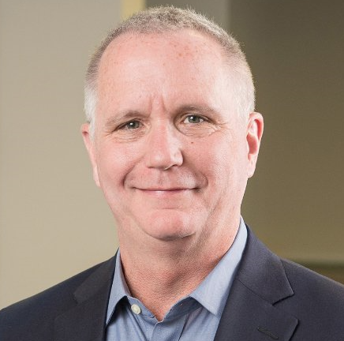
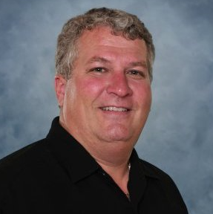
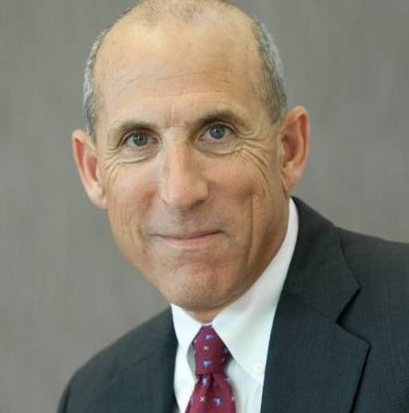
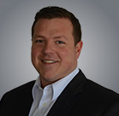
PANEL: Vendor Cyber Issues
Joe Magrady
Jerry Fox
Doug Johnston
Bryce Lee

Slide 9
WORK GROUPS:
Strategic Future Issues
&
Customer Experience
Rick Morgan

Slide 10
WORK GROUP:
Security
Chair:
Steve Aronson

Slide 11
BREAK TIME!
Be back in 20 MINUTES

Slide 12
WORK GROUP:
Small Commercial Real Time Rating
Jim Armitage
Susan LaBarre
Co-Chairs:

Slide 13
WORK GROUP:
eSignature
Joyce Sigler
Nick Khamarji, Jr.
Co-Chairs:

Slide 14
Telematics ‘TED’ Talks
Kevin Ament
John Condon
Dwight Holcomb

Slide 15
Wrap-Up
Observations
Next Steps, Questions
Next ACT Meetings, Future

Slide 16
Future ACT Meetings
** Moving to 2x/Year starting 2016
Feb 17-19, 2016 – w/AUGIE
Scottsdale, AZ
Nov 1-3, 2016 – w/ACORD2016
Boca Raton, FL
www.iiaba.net/ACT ‘Events’ tab

Slide 17
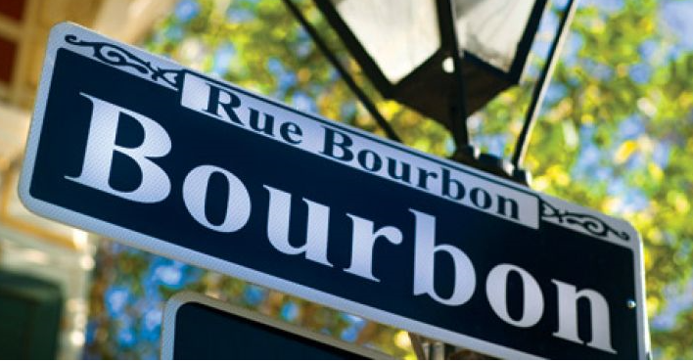
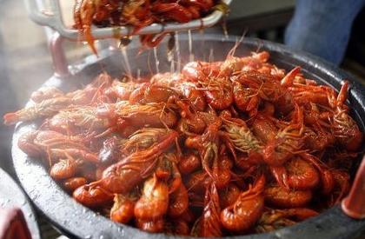
Thank you!
5:00 pm – 6:00 pm Trusted Choice.com Strategy Update/Open Forum – same room Ryan H
6:00 pm – 7:00 pm Young Agents Awards Reception – Waldorf Astoria Ballroom, Mezzanine Level
Dinner on your own – Enjoy!

