Slide 1
Efficient Vehicle Assessor™
Profitable Insurance Innovation
Agents Council for Technology
Oct 2, 2015

Slide 2
Insurance Agents and the Efficient Vehicle Assessor Pilot
Connects gas pumps to the Internet of Things to enable transactions for insurance, etc.
Creates a new distribution channel for independent agents
Can accelerate adoption of UBI without requiring on-board devices
Provides group sales opportunity to millions of ETC users
Creates platform for product innovation and enhanced customer service
Saves drivers hundreds of dollars annually

Slide 3
Partner development
E-ZPass Group and States
E-ZPass Group to join pilot, co-market and endorse Verdeva transactions
State discussions in MA, NY MD, DE, FL, IL and CA
Insurance
Carriers (national and regional)
Independent agent channels
Fuel retailers in MA, NH, NY, PA, MD, FL, GA
Retail innovators – offering retail discount and rebate programs
Technical partners:
Kapsch TrafficCom
LogMeIn/Xively
Freescale Semiconductor
Verifone
Notes:
State Pilot Discussions: Maryland, Delaware, New York, Massachusetts, Connecticut. I-95 Corridor Coalition.
Developing business and technical partners key to Verdeva value chain:
LogMeIn/Xively: Industry leading IoT solution provider.
E-ZPass/Kapsch Trafficom: ITS company with contract to provide E-Zpass technology (transponders, readers, toll systems, etc.)
Fuel Retailers: major brand hyper-station discussions underway.
Auto Insurance: national and regional brand insurance and risk data aggregator discussions underway.
Payment Innovators: payment processing innovators focused on fuel-retailers and motorists.
Wilson Sonsini Goodrich & Rosati: Premier legal advisor to technology and growth enterprises.

Slide 4
About EVA

Slide 5
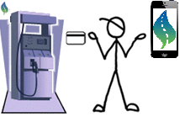
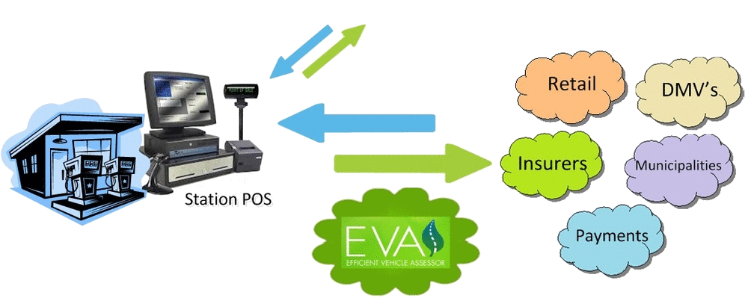
Verdeva’s “Efficient Vehicle Assessor”
EVA connects the gas pump to the Internet of Things to offer simple and secure personalized transactions
(1) Vehicles identified by toll transponder ID, EVA retrieves vehicle information
(2) Card swipe enables EVA‘s apps at the pump and on the smartphone

Slide 6
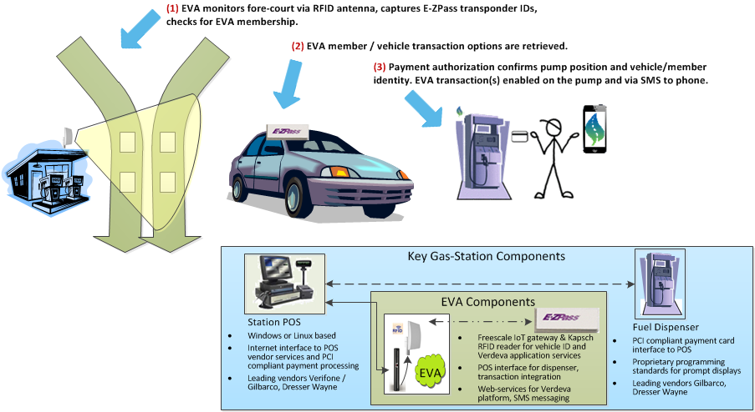
EVA Field Components

Slide 7
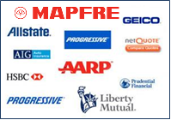
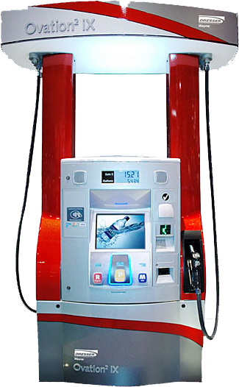
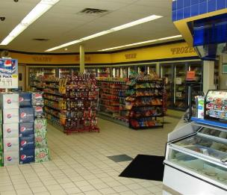
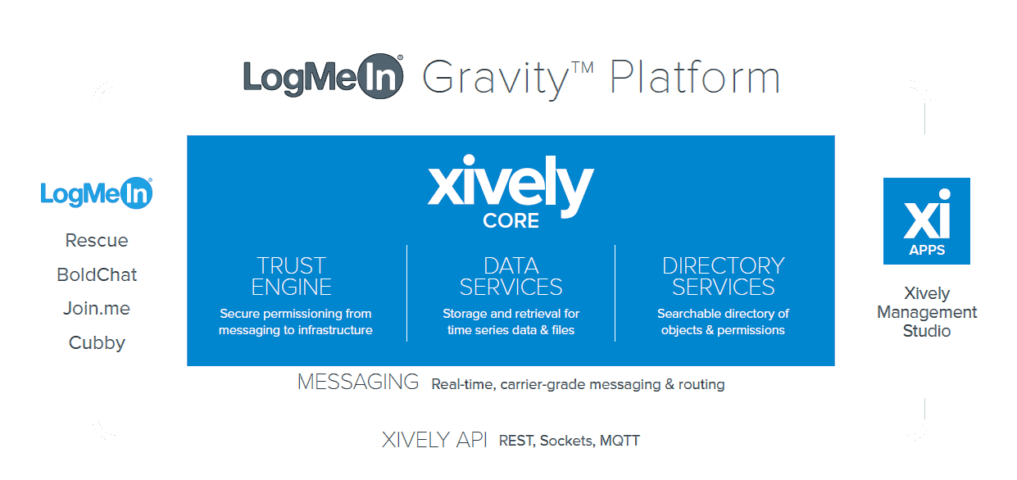
EVA Platform Overview
Retail
Insurance
POS / IoT gateway
Rescue
Bold Chat
Join.me
Cubby
TRUST ENGINE
Secure permissioning from messaging to infrastructure
DATA SERVICES
Storage and retrieval for time series data and files
DIRECTORY SERVICES
Searchable directory of objects and permissions
Xively Management Studio
MESSAGING Real-time, carrier grade messaging & routing
State & Local
XIVELY API Rest, Sockets, MQTT

Slide 8
The Pump and the Pass
The Pump
150,000 fuel retailers with 1 million dispensers
Total visits per day (U.S.): 40 million
Time of average visit: 4 minutes
Secure payment preauthorized
Retailers need new revenue streams
The Pass (E-ZPass™)
16 million E-ZPass accounts/27 million vehicles
Vehicle identification already on board
E-ZPass Group seeks new consumer apps, will promote EVA to its customer base
EVA will support SunPass, federal requirements for ETC interoperability by October 2016
Notes:
The gas pump and E-Zpass (and eventually other toll transponders)
Average motorist refuels nearly 60 times per year.
Most of the visit is idle time staring at the pump.
When the motorist swipes their card to start transaction, they preauthorize secure payment.
E-Zpass is in use throughout the Eastern seaboard plus Ohio and Indiana.
Brand managed by interstate quasi-government organization, E-Zpass Group (part of the I-95 Corridor Coalition, which consists of the tolling authorities in states along Interstate 95).
E-Zpass Group interested in retailer partnerships. (See C-store account sales, use of E-Zpass for parking lot payments, even fast-food drive-through payment experiment)
All electronic toll collection (ETC): national priority.
Reader technology now open source.

Slide 9
Verdeva connects fuel retailers to the digital economy
Insurance
DMV Payments
Fines & Fees Payments
Retail Options
EVA provides new revenue channels, customer incentives; enhances retail experience with time- and cost-saving options; delivers generous revenue share to retailers
Group sales to 10’s of millions of ETC users
UBI and other product innovation, a $20-50B market in 5 years
Simple DMV transactions
$2-3 billion market in registration renewals alone
Convenient payment of fines and fees
$7 billion market
Product sales at the pump
Retail innovation
Personalized reminders
Notes:
Essentially, what we do is bring the gas station’s storefront into the digital economy.
You can see the muscle we add to the pumps:
PAYDAYS insurance products, a $34 billion market in 5 years, saving consumers $100 to $400 per year compared to conventional insurance premiums
Simple DMV transactions, a $2.5 billion market in just registration renewals.
DMV reminders (for example, inspection due)
Quick DMV transactions like registration renewals). (Only registration renewal fees are in the business model, although other simple transactions are possible).
Easy, convenient interface for payment of fines, fees and tolls – an $8 billion market. Consumers can pay installments, something not possible now.
A number of retail options that include
Support for the sale of alternative fuels, especially avoiding E15 misfueling,
Adding a lot of power to their retail loyalty programs, etc. For example, instead of a loyalty card earning you points toward a Slurpy, we could add serious benefits into the mix.
Essentially a free stolen-vehicle locator at every gas pump
Pumps tied into AMBER Alert systems
And here’s the result of improving their customer’s experience: We pay a generous share of fees to the station. And all of this without charging for setup or maintenance!

Slide 10
First Stage: Consumer Apps Second Stage: EVA Policy Apps

Slide 11
First Stage: Consumer Apps
EVA Group & Pay-As-You-Drive-And-You-Save™ Insurance
EVA E-ZPay™ – Convenient vehicle-centric transactions
EVA Affinity™ – Customized reminders, retail offers
Notes:
Because we know the exact vehicle at the pump, AND the consumer, we can complete additional secure transactions with extremely simple Yes/No questions.

Slide 12
EVA Group and PAYDAYS Insurance
EVA Group provides personalized marketing at the pump or by text
E-ZPass membership presents a large group opportunity to insurance partners
Option to discount based on known demographics
EVA PAYDAYS – usage-based insurance (UBI)
90% of consumers interested in UBI to save $100s annually
Nearly 50% have privacy concerns
EVA PAYDAYS delivers a “UBI-lite” that overcomes privacy, technical and cost hurdles while capturing the major actuarial data needed for usage pricing (mileage)
Notes:
Verdeva will establish agency relationships in each state that we operate, and will ask for a fraction of the commission than is standard for the industry, to produce and support EVA PAYDAYS policies.
Insurer profitability is enhanced while the consumer saves money.
Although we charge much less, our IoT-based connection to the customer and vehicle puts us in position to deliver extremely personalized and high-touch services, delivering very high consumer satisfaction, as well as unique features and services, including:
Convenience reminders and messages related to premium payments, renewals, claims and account services
Innovative premium payment options; e.g., pay-as-you-go
Extremely responsive and informed customer service. We will have the full person, vehicle, and member profile including EVA transaction history in front of our call center representative instantly. We will leverage our IoT-connected CRM backend software, making contact with our call centers quick, informed, and multi-channel.
Down the road:
Integrated and on-demand proof-of-coverage service
On-demand and variable coverage options

Slide 13
PAYDAYS allows UBI market to fulfill its potential
On-board device (OBD) hinders UBI adoption
EVA overcomes cost, technical and privacy hurdles
Cost | On-board telematics are costly hurdle for insurers Wireless data plans expensive Cost is 40x-60x more than EVA | Telematics at the pump, not car No capital investment by insurer Cuts cost by 40x-60x versus OBD
Technical | Devices/vehicles are not standardized Cell phones not always present Battery drainage | EVA identifies any vehicle by RFID at the pump OBD access not needed Wireless data transfer not needed
Privacy | Tracking driver behavior raises concerns Some states only allow mileage-based usage to be considered | Does not require driver-behavior tracking Apps are opt-in No perceived “snooping”
Notes:
Despite the promised growth and the readiness of the market (over 40% of insurers, and all major brands, already have UBI offerings), adoption is slow, and is currently only 1-to-2% of the market.
This is EVA’s central value proposition for the insurance market: we remove obstacles, allowing the UBI market to fulfill its potential. We very directly overcome privacy, cost, and technical hurdles.
Cost: EVA does not require on-board devices, instead, telematics are at the pump, and mileage is verified based on refueling, online data and consumer interaction.
Verdeva delivers EVA PAYDAYS with no field capital investment required by the insurer.
Technical: EVA identifies any vehicle by RFID at the pump; enables frictionless enrollment; does not require access to on-board diagnostics or wireless usage data transmission (which can cost as much as $5 per month)
Privacy: EVA PAYDAYS does not require driver behavior tracking. Apps are opt-in, eliminating privacy concern
And in the future, as OBD and NFC access gain market share Verdeva will integrate with it as well to enrich the vehicle/driver data profile and add program options for EVA membership. Data capture at the pump or refueling station will continue to offer feature and cost benefits vs. wireless.

Slide 14
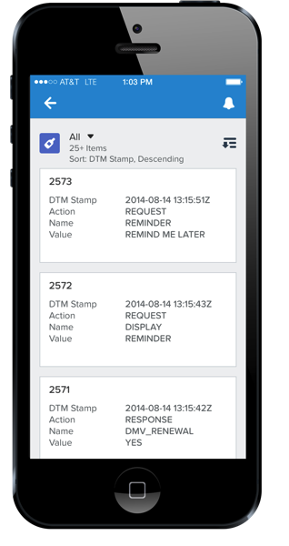
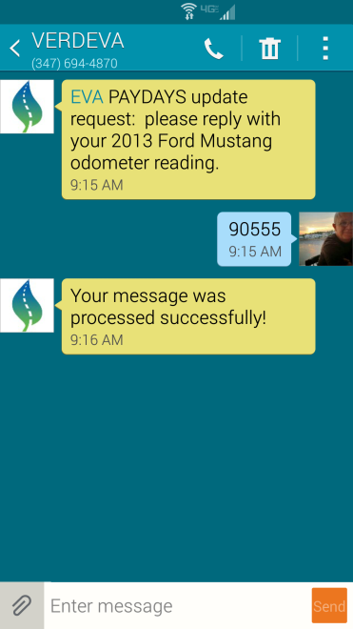
PAYDAYS – occasional mileage verification
On the phone:
Start
Welcome
Pay Inside
During refueling, at the pump or on the phone…
Pay Credit Here
Pay Debit Here
At the pump:
EVA PAYDAYS update request: Please enter your 2013 Ford Mustang current odometer reading:
[ _ _ _ _ _ _ ]
Finish
Thank you – Print Receipt?
Yes
No
OK
Not now
Receipts will include EVA transactions
Notes:
Verdeva will establish agency relationships in each state that we operate, to produce and support EVA PAYDAYS policies.
Insurer profitability is enhanced while the consumer saves money.
Our IoT-based connection to the customer and vehicle puts us in position to deliver extremely personalized and high-touch services, delivering very high consumer satisfaction, as well as unique features and services, including:
Convenience reminders and messages related to premium payments, renewals, claims and account services
Innovative premium payment options; e.g., pay as you go.
Future options
On-demand proof-of-coverage service
On-demand and variable coverage options
Extremely responsive and informed customer service. We will have the full person, vehicle, and member profile including EVA transaction history in front of our call center representative instantly. We will leverage our IoT-connected CRM backend software, making contact with our call centers quick, informed, and multi-channel.

Slide 15
EVA’s insurance offerings – other innovative features
Convenient and captive consumer interaction at the pump or on the phone
Payment reminders
Innovative payment plans
Temporary product options
On-demand proof-of-coverage
No-charge mileage verification and usage data

Slide 16
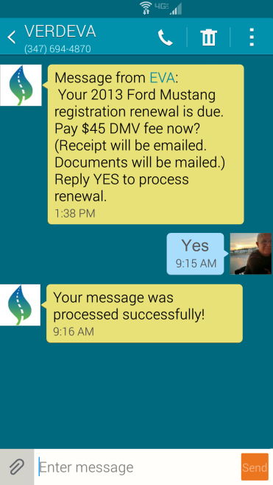
EVA E-ZPay – one-touch convenience payment options
On the phone:
Start
Welcome
Pay Inside
During refueling, at the pump or on the phone…
Pay Credit Here
Pay Debit Here
EVA: Your 2013 Ford Mustang insurance payment is due.
Pay $70 premium payment now? (Receipt will be emailed.)
At the pump:
EVA update: Your 2013 Ford Mustang insurance payment is due.
Pay $70 premium payment now? (Receipt will print.)
Finish
Your message was processed successfully
Thank you – Print Receipt?
Yes
No
Ok
Not now
Receipts will include EVA transactions

Slide 17
EVA E-ZPay – one-touch convenience payment options
On the phone:
Start
Welcome
Pay Inside
During refueling, at the pump or on the phone…
Pay Credit Here
Pay Debit Here
EVA: Your 2013 Ford Mustang registration renewal is due.
Pay $45 DMV fee now? (Receipt will be emailed. Documents will be mailed.)
At the pump:
EVA update: Your 2013 Ford Mustang registration renewal is due.
Pay the $45 DMV fee now? (Receipt will print. Documents will be mailed.)
Finish
Your message was processed successfully
Thank you – Print Receipt?
Yes
No
Ok
Not now
Receipts will include EVA transactions

Slide 18
Second Stage: EVA Policy Apps
EVA Estimated Miles Driven and Compliance applications

Slide 19
EVA seen as a policy game-changer by very senior officials
Policy Challenge | Verdeva Solution
Sustainable transportation funding (failed gas tax) | Politically viable alternative to gas tax
Non-tax revenues needed to balance budget. | Non-tax revenues captured at the pump
Non-compliant vehicles cost billions of dollars | Identification at-the-pump enables compliance opportunity
Environment | Market-based incentives to reduce carbon emissions
Solutions are expensive | No cost to government to install or maintain system
Notes:
Sustainable Transportation Funding: The gas tax is failing badly due to increasing fuel efficiency. We enable a politically viable alternative to gas tax.
Environment: There’s an urgent need for more effective market-based incentives to reduce carbon emissions.
Fiscal health: There is a desperate need to find non-tax revenues to balance budgets.
Law enforcement: Non-compliant vehicles cost legitimate drivers and governments billions of dollars.
Insurance: One in six drivers are uninsured, costing insured drivers nearly $12 billion yearly.
Registration: Unregistered vehicles in states cost taxpayers $150 million or more in lost fees. (At least 3%, probably much more, are unregistered.)
Toll Evaders: As toll gates come down, toll evasion is going up, costing millions of dollars which are expensive to collect. EVA can require payment at the pump.
Parking Scofflaws: Over $4B owed nationally to cash-strapped localities.
Thefts and Amber Alerts: EVA can quietly notify police departments of stolen vehicles at the pump
No cost to government to install or maintain system.

Slide 20
EVA Estimated Miles Driven (EMD) apps for sustainable transportation funding
Feature | Gas Tax | VMT (public perception) | EVA EMD | EVA Advantage
Invasion of Privacy? | No | Yes | No | EVA does not track vehicles. GPS-based VMT does.
Self-funded installation? | N/A | No | Yes | A public-private venture, EVA’s installation/operation is self-funding.
Different rate for rural drivers? | No | No | Yes | This will be viewed very favorably by rural drivers.
Tiered, segmented rates? | No | No | Yes | EVA enables a progressive pricing structure based on type of user and usage (e.g., occupational).
User Fee? | Yes | Yes | Yes | EVA and gas tax are consumption-based user fees. VMT is actual mileage.
Incentivize efficient vehicles? | Yes | No | Yes | EVA is a truly transformative tool in effort to reduce carbon emissions.

Slide 21
EVA policy apps support inevitable transportation policy reform
States mandate a solution for transportation funding and other transportation policies
Electronic vehicle identification key to solution
EVA will be positioned as solution of choice
Stage 1 consumer apps in place
Same vehicle ID model as electronic tolling systems
Pump rather than vehicle-based telematics
No-cost business model
The prospect: EVA adopted at 100% of stations
State mandate can be just to put RFID at the pump (versus mandating that every car get an OBD)

Slide 22
Thank You
For additional information:
John Condon
Research Director
jcondon@verdevinc.com
914-450-6538
www.verdevainc.com

